Slide 1

HELP International
NGO Assignment
Hemant Badgujar

Slide 2
Problem Statement
How to use $ 10 Million money strategically and effectively for fighting poverty and providing the people of backward countries with basic amenities and relief during the time of disasters and natural calamities.
Goal as a Data Analyst
Categorise the countries using some socio-economic and health factors that determine the overall development of the country.
Suggest the countries which the CEO needs to focus on the most.

Slide 3
Approach & Steps
Data Reading
Checking the data quality
Scaling Dataset
PCA
For Dimensionality Reduction
And to tackle with the issue of Multicollinearity in the data
Hopkins Statistics to know the clustering tendency
Model Building
KMeans Clustering
With “4” clusters
And also “3” clusters
Hierarchical Clustering
And also 3 clusters
Visualizing the Clusters formed

Slide 4
Details/Exceptions on the steps followed
Though we could see the outliers in the main dataset, we decided to remove it after the PCA. Hence, Outlier treatment is carried out on the PCA dataframe
Scaling of data was performed using “Standard Scaler”
Correlation Plot shows high correlation between multiple parameters and hence, we choose to go with PCA. And left it on to PCA to handle the multicollinearity issue
Correlation after PCA shows almost 0 or less than 0 values
Selected only five variables after clustering for easy and effective visualization to decide on the countries in need of funding

Slide 5
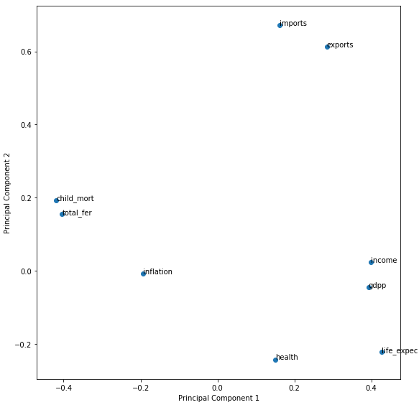
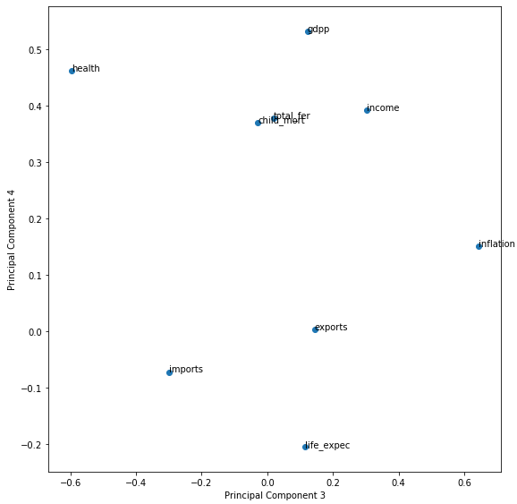
Principal Component Analysis (PCA)
Highly scattered data across all the variables
Selected 4 principal components based on the scree plot
All the four principal components are the linear combination of 9 original variables
Each Principal component has added loadings which captures the maximum variance in the data in decreasing order
Principal Component 1
Heavy loading on Socio economic parameters like, gdpp, income and seem to have been representing the same
Principal Component 2
Heavy loading on parameters like, import, export, child mortality, total fertility etc and seem to have been representing the same
Most of the parameters have loading between 0 to 0.2
Principal Component 3
Heavy loading on inflation parameters and other parameters have the values between 0 to 0.2
Principal Component 4
Heavy loading on gdpp, health parameters and mostly parameters have the values between 0.3 to 0.6

Slide 6
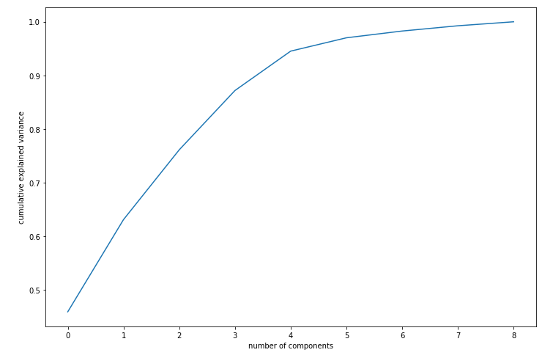
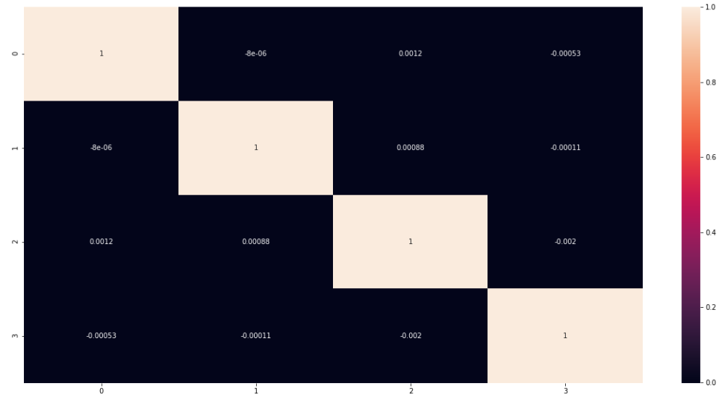
Principal Component Analysis (PCA)
PCA helped in reducing the dimensions from 9 variables to 4 variables
Scree plot suggested 4 Principal components which captures around 95% variance in the data
Correlation plot on PCA dataset show almost 0/less correlation between the components

Slide 7
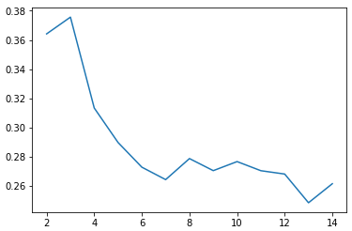
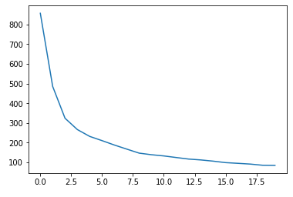
Hopkins Statistics, Silhouette Statistics & Sum Squared distances
Hopkins coefficient came out to be 0.74 which tells a fair tendency in cluster formation
Silhouette plot suggested the optimum k value as ‘3’
Sum Squared distances plot suggested the optimum k value range between 2 to 5

Slide 8
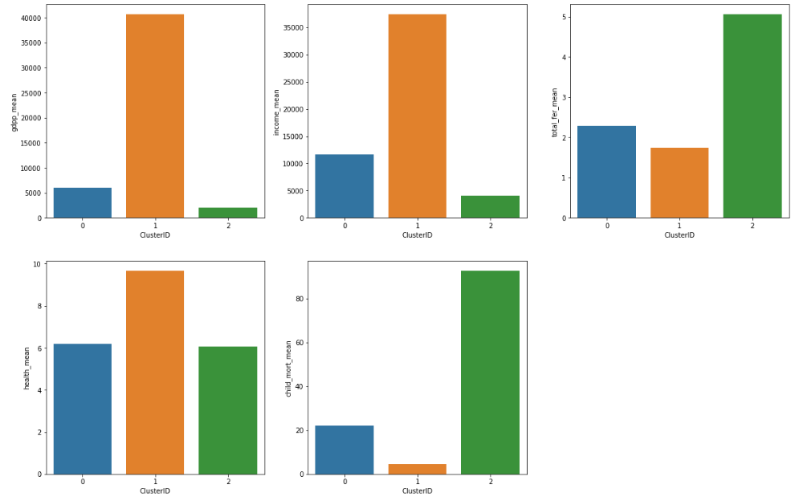
KMeans Clustering (with 3 Clusters)
Cluster 02
Seems to be with very less gdpp, income and also the fertility, child mortality is high
Countries falling under cluster 02 is in the direst need of aid
Cluster 00
With second lowest gdpp, income and also the fertility, child mortality is high
Countries falling under cluster 00 is on the second priority of need of aid
Cluster 01
With highest gdpp, income and also the fertility, child mortality is low
Countries falling under cluster 01 doesn’t seem to be of any need of aid
Initialized with KMeans++ algorithm for smart selection of cluster centers
ClusterID | gdpp | Income | Fertility | Child mortality | Health spend
00 | Low | Low | Low | Low | Low
01 | High | High | Lowest | Lowest | High
02 | Lowest | Lowest | High | High | Lowest

Slide 9
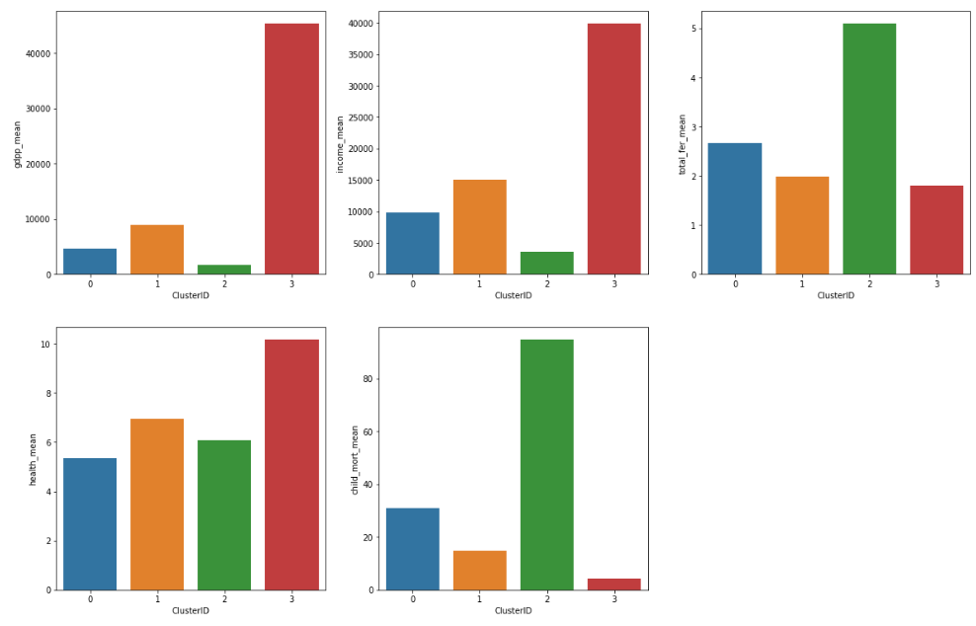
KMeans Clustering (with 4 Clusters)
Cluster 02
Seems to be with very less gdpp, income and also the fertility, child mortality is high
Countries falling under cluster 02 is in the direst need of aid
Cluster 00
With second lowest gdpp, income and also the fertility, child mortality is high
Countries falling under cluster 00 is on the second priority of need of aid
Cluster 01
With high gdpp, income and also the fertility, child mortality is average
Countries falling under cluster 01 is on the third priority of need of aid
Cluster 03
With highest gdpp, income and also the fertility, child mortality is low
Countries falling under cluster 01 doesn’t seem to be of any need of aid
Initialized with KMeans++ algorithm for smart selection of cluster centers
ClusterID | gdpp | Income | Fertility | Child mortality | Health spend
00 | Low | Low | High | High | Lowest
01 | High | High | Low | Low | High
02 | Lowest | Lowest | Highest | Highest | Low
03 | Highest | Highest | Lowest | Lowest | Highest

Slide 10
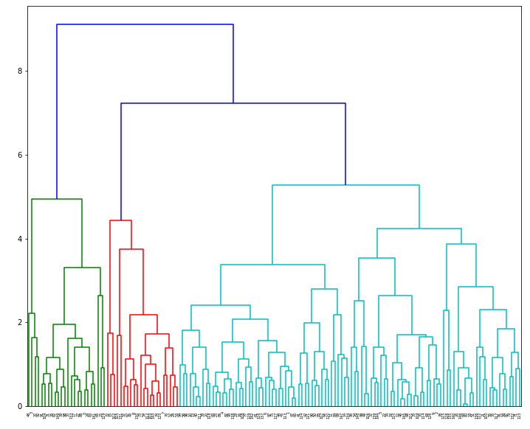
Hierarchical Clustering
Dendogram was build using agglomerative clustering technique with linkages method as “complete”
For the effective utilization of available funds, thought of going for 4 clusters (cut at value 5) rather than going for 3 clusters (cut at value 6)

Slide 11
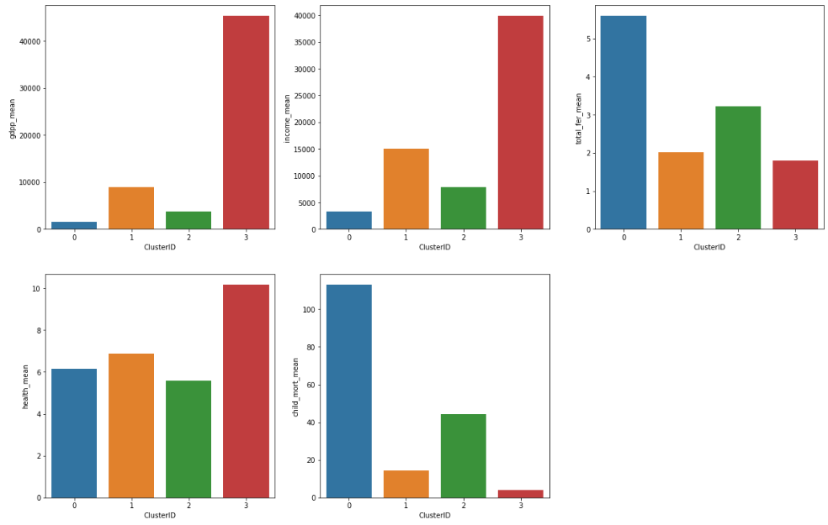
Hierarchical Clustering (with 4 Clusters)
Cluster 00
Seems to be with very less gdpp, income and also the fertility, child mortality is high
Countries falling under cluster 00 is in the direst need of aid
Cluster 02
With second lowest gdpp, income and also the fertility, child mortality is high
Countries falling under cluster 02 is on the second priority of need of aid
Cluster 01
With high gdpp, income and also the fertility, child mortality is average
Countries falling under cluster 01 is on the third priority of need of aid
Cluster 03
With highest gdpp, income and also the fertility, child mortality is low
Countries falling under cluster 01 doesn’t seem to be of any need of aid
Initialized with metric ‘Euclidean’ distance
ClusterID | gdpp | Income | Fertility | Child mortality | Health spend
00 | Lowest | Lowest | Highest | Highest | Low
01 | High | High | Low | Low | High
02 | Low | Low | High | High | Lowest
03 | Highest | Highest | Lowest | Lowest | Highest

Slide 12
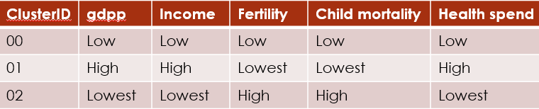
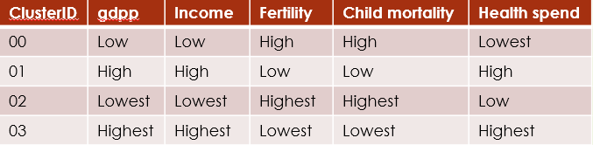
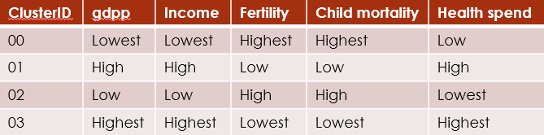
KMeans Clustering (with 3 Clusters)
KMeans Clustering (with 4 Clusters)
Hierarchical Clustering
List of Countries (ClusterID 02)
List of Countries (ClusterID 02)
List of Countries (ClusterID 00)
Afghanistan
Angola
Benin
Botswana
Burkina Faso
Burundi
Cameroon
Central African Republic
Chad
Comoros
Congo, Dem. Rep.
Congo, Rep.
Cote d'Ivoire
Equatorial Guinea
Eritrea
Gabon
Gambia
Ghana
Guinea
Guinea-Bissau
Haiti
Iraq
Kenya
Lao
Madagascar
Malawi
Mali
Mauritania
Mozambique
Namibia
Niger
Pakistan
Rwanda
Senegal
Sierra Leone
South Africa
Sudan
Tanzania
Timor-Leste
Togo
Uganda
Yemen
Zambia
Afghanistan
Angola
Benin
Botswana
Burkina Faso
Burundi
Cameroon
Central African Republic
Chad
Comoros
Congo, Dem. Rep.
Congo, Rep.
Cote d'Ivoire
Equatorial Guinea
Eritrea
Gabon
Gambia
Ghana
Guinea
Guinea-Bissau
Haiti
Kenya
Lao
Madagascar
Malawi
Mali
Mauritania
Mozambique
Namibia
Niger
Pakistan
Rwanda
Senegal
Sierra Leone
South Africa
Sudan
Tanzania
Timor-Leste
Togo
Uganda
Yemen
Zambia
Afghanistan
Angola
Benin
Burkina Faso
Burundi
Cameroon
Central African Republic
Chad
Congo, Dem. Rep.
Congo, Rep.
Cote d'Ivoire
Equatorial Guinea
Guinea
Guinea-Bissau
Haiti
Malawi
Mali
Mauritania
Mozambique
Niger
Sierra Leone
Tanzania
Uganda
Zambia

